Slide 1
Occupant Classification System
Team Members:
Rohith Raju
DelliPriya P
Ritik Rokade
Santhosh Kumar
Shraddha Chakraborty

Slide 2
Requirements
ID | Object Type | Object Text | Status | Task ID | Review ID | Remarks
OSC_ID1 | Heading | Seat belt status | Proposed | 1
OSC_ID2 | Definition | Checking message is receiving or not. LED:- Light Emitting Diode is it semiconductor device which can emitte light when an electric current passes through it. Register:- Register is a memory which is used to store data and fetch the data to CPU. CAN:- Controller Area Network, can is a mesaage based protocol for using transmitting and receiving the messages. | Proposed | 1
OSC_ID3 | Comment | Using CANCON register we are setting different modes and buffers (TX and RX) | Proposed | 1
OSC_ID4 | Requirement | 1. Receiving CAN message from seat belt status. | Proposed | 1
OSC_ID5 |  | 2. If message is receving LED should be in OFF. | Proposed | 1
OSC_ID6 |  | 3. If message is not receving LED should be in ON. | Proposed | 1
OSC_ID7 |  | 4. Store the data in EEPROM byte 2 at bit 2 and bit 3. | Proposed | 1
OSC_ID9 | Heading | Occupant Status | Proposed | 2
OSC_ID10 | Definition | Checking passenger status. PUSH-UP SWITCH:- A push-up switch is a memontary or non-latching switch which causes a temporary changing the state of an electrical circuit only while the switch is physically actuated. | Proposed | 2
OSC_ID11 | Comment |  | Proposed | 2
OSC_ID12 | Requirement | 1. If push switch 3&4 both are OFFthen LED is ON ,we are transmiting byte 0 at bit 0 and bit 1 both are cleared then it is a child occupant. | Proposed | 2
OSC_ID13 |  | 2. If push switch 3 is off 4 is on then the LED is OFF,we are transmiting byte 0 at bit 0 is clear and bit 1 is set then it is a 95% adult occupant. | Proposed | 2
OSC_ID14 |  | 3. If push switch 3 is on 4 is off then LED is blink for every 5 sec,we are transmiting byte 0 at bit 0 is set and bit 1 is clear then it is a small adult occupant. | Proposed | 2
OSC_ID15 |  | 4. If push switch 3 and 4 both are on then LED is blink for every 10 sec,we are transmiting byte 0 at bit 0 and bit 1 both are set then it is an empty occupant. | Proposed | 2
OSC_ID16 |  | 5. Store the data in EEPROM. | Proposed
OSC_ID17 | Heading | Passenger Air bag status | Proposed | 3
OSC_ID18 | Definition | Checking air bag is enable or disable. | Proposed | 3
OSC_ID19 | Comment | AIRBAG:- Airbag is safety device fitted inside a road vehicle, consisting of a cushion designed to inflate rapidly and protect passengers from impact in the event of collision. | Proposed | 3
OSC_ID20 | Requirement | 1. If Seat belt message is received and person is occupied then air bag should be enable. | Proposed | 3
OSC_ID21 |  | 2. If Seat belt message is not received and person is occupied then air bag should be disable. | Proposed | 3
OSC_ID22 |  | 3. In byte 7 setting bit 0 for storing data in EEPROM | Proposed | 3
OSC_ID23 |  | 4. Transmiting data using this ID:0x99 to the instrument cluster. | Proposed | 3

Slide 3
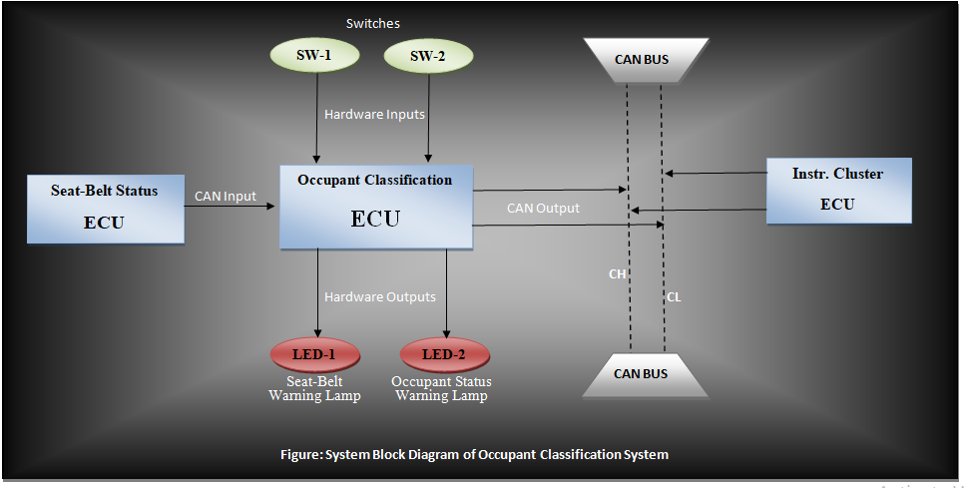
System Block Diagram of Occupant Classification System

Slide 4
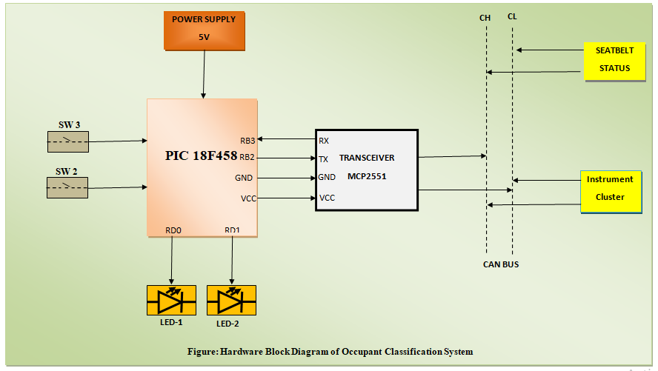
Hardware Block Diagram of Occupant Classification System

Slide 5
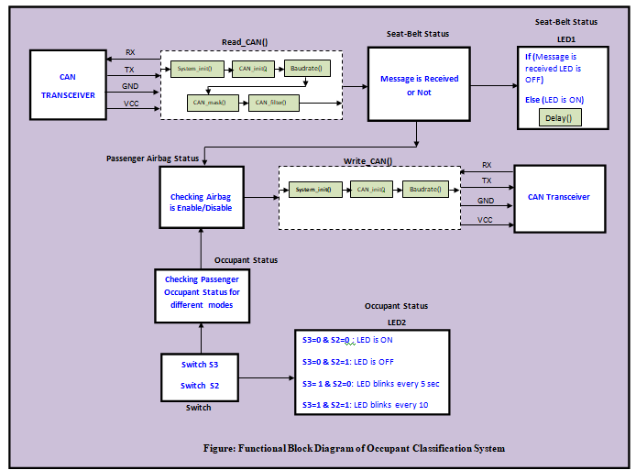
Functional Block Diagram of Occupant Classification System

Slide 6
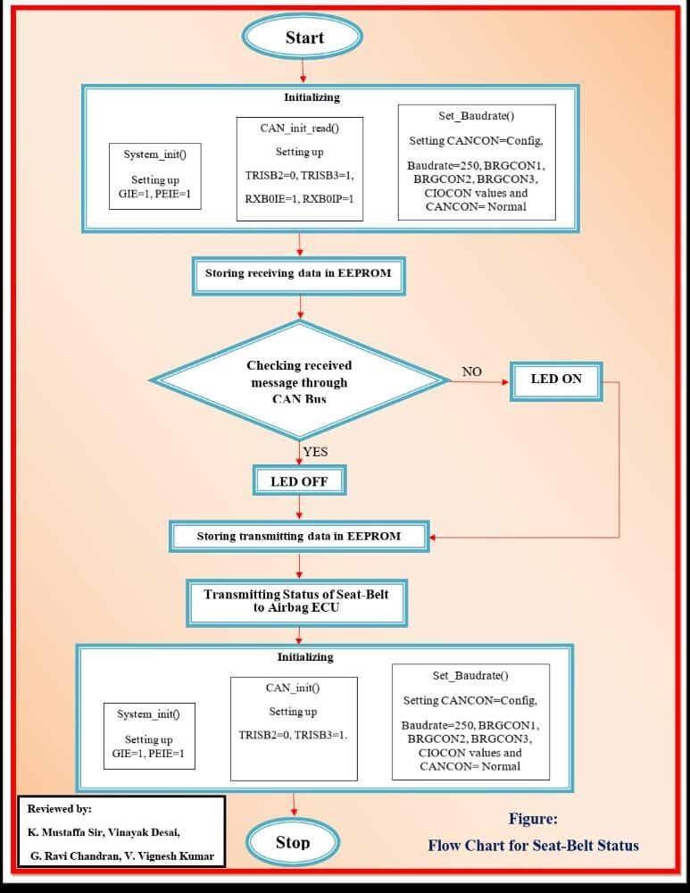
Flowchart for Seat-Belt Status

Slide 7
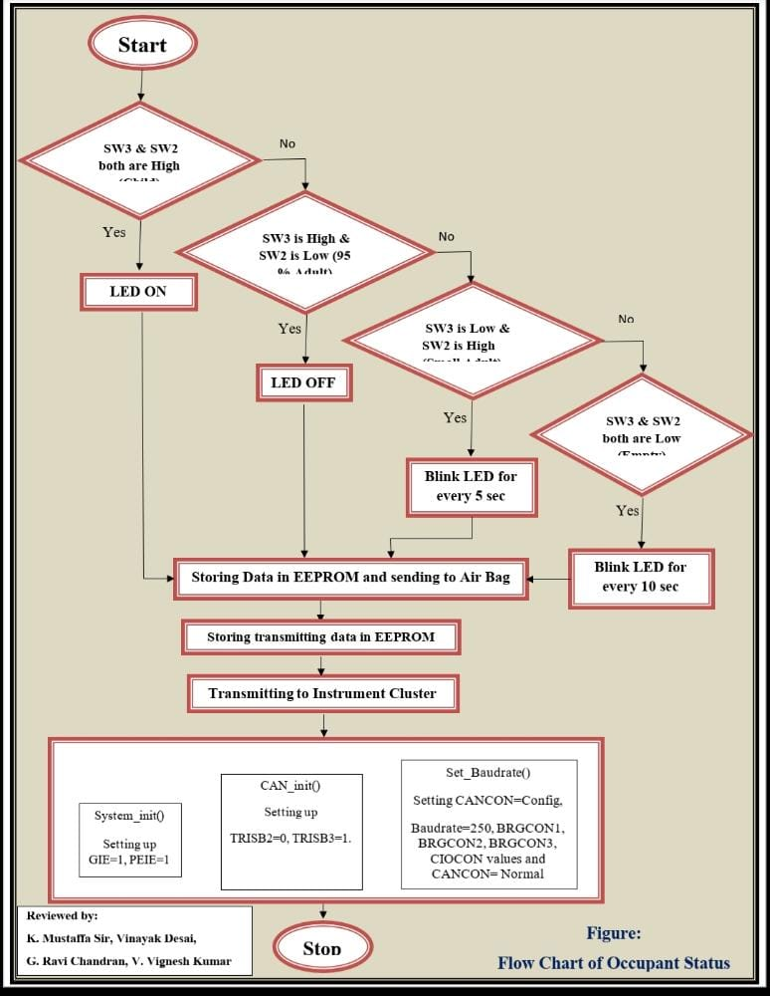
Flowchart of Occupant Status

Slide 8
Test Cases
Test Case ID | Precondition | Test Case Steps | Expected | Obtained | Verdict(Pass/Fail)
OCS001 | 1. Connecting ECU to CAN BUS 2. Connected Power Supply | Checking CAN Bus connected or not | CAN Bus must be connected | CAN bus is connected | Pass
OCS002 |  | Checking message is receiving or not from CAN Bus | Message is receiving from CAN Bus | Message is recevied | Pass
OCS003 |  | Message is receiving | LED should be OFF | LED OFF | Pass
OCS004 |  | Message is not receiving | LED should be ON | LED ON | Pass
OCS005 |  | Storing data (Write) in EEPROM | We must read the data which writen in EEPROM | Written the data | Pass
OCS006 | 1.Connected Power Supply 2. Connections of LED and Switches | Manually giving input for Switch 3 and 2 | Manually input should be received | Inputs are recevied | Pass
OCS007 |  | Turning OFF 3 and 2 both switches | LED Should be ON (Child) | LED ON | Pass
OCS008 |  | Turning Switch 3 is OFF and Switch 2 is ON | LED Should be OFF (95% Adult) | LED OFF | Pass
OCS009 |  | Turning Switch 3 is ON and Switch 2 is OFF | LED Should be blink for 5 Sec. (Small Adult) | LED blinking for 5 sec | Pass
OCS010 |  | Turning Switch 3 is ON and Switch 2 is ON | LED Should be blink for 10 Sec. (Empty Occupant) | LED blinking for 10 sec | Pass
OCS011 |  | Storing data (Write) in EEPROM | We must read the data which writen in EEPROM | Written the data | Pass
OCS012 | 1. Connecting Power Supply 2. Connecting AirBag ECU 3. Transmitting Seatbelt Status and Occupant Status to ECU | Checking seatbelt status message is received and person occupied. | Airbag should be enable | Air bag enabled | Pass
OCS013 |  | Checking seatbelt status message is not received and person occupied. | Airbag should be disable | Air bag disabled | Pass
OCS014 |  | Checking seatbelt status message is received and person not occupied | Airbag should be disable | Air bag disabled | Pass
OCS015 |  | Checing seatbelt status message is not received and person not occupied | Airbag shold be disable | Air bag disabled | Pass
OCS016 |  | Storing data (Write) in EEPROM | We must read the data which writen in EEPROM | Written the data | Pass
OCS017 |  | Transmitting data through CAN Bus | Message must be transmit through can CAN Bus | Transmitting the messages | Pass

Slide 9
Thank You

